Slide 1
EE 210
LECTURE 4-PART 1
TECHNIQUES OF CIRCUIT ANALYSIS
Cenk Efeler
Reference Book :Electric Cırcuits
James W.Nielson & Susan A.Riedel

Slide 2
PLANAR CIRCUITS
The circuits that we have studied so far are called planar circuits.A planar circuit is a circuit that can be drawn on a plane without crossing branches.A circuit with crossing branches is still considered planar,if it can be redrawn with no crossover branches.
The circuit in Figure 4.1(a) can be rdrawn as in Figure 4.1(b).These two circuits are equivalent,since the node connections have been kept.Thus the circuit in Figure 4.1(a) is considered planar.

Slide 3
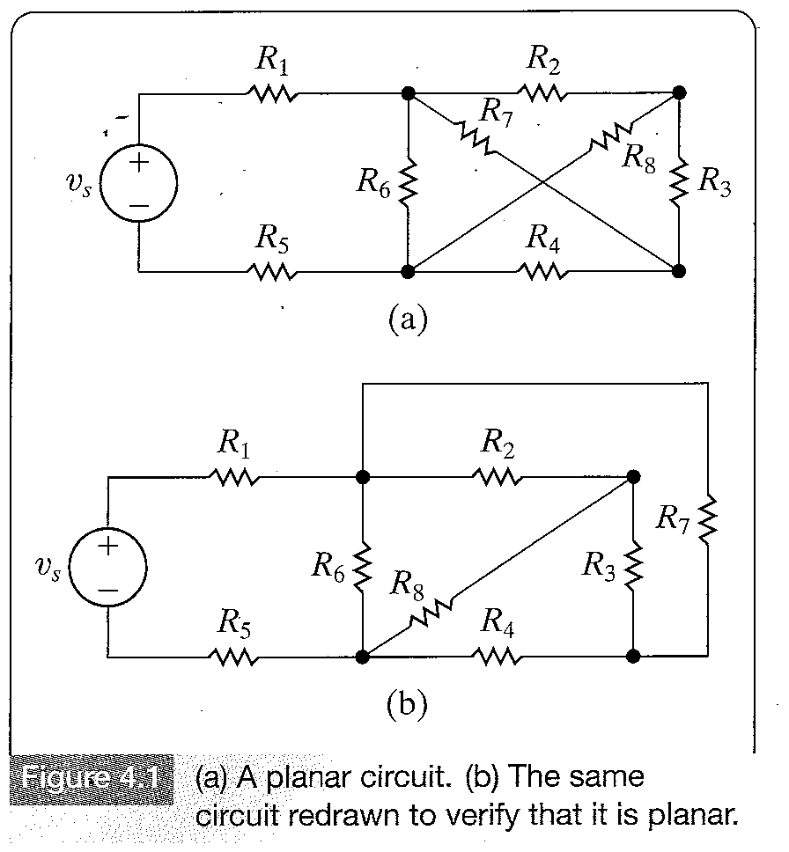
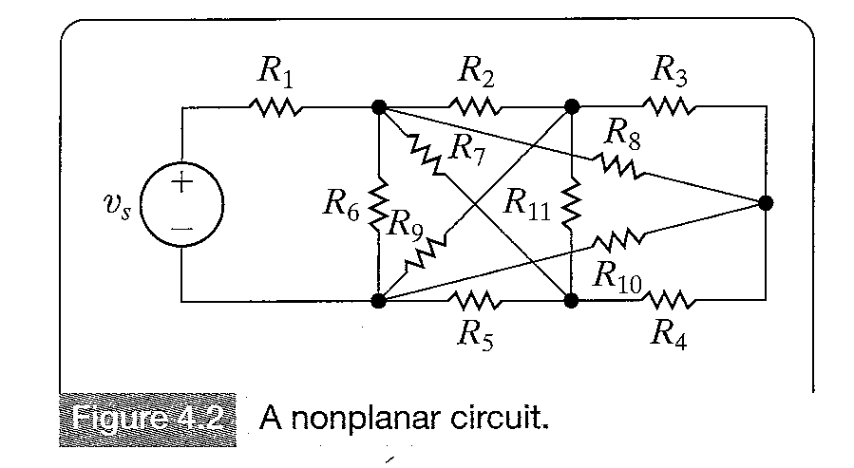
PLANAR CIRCUITS

Slide 4
PLANAR CIRCUITS
The node-voltage method is applicable to both planar and non-planar circuits,whereas the mesh-current method is limited to planar circuits.

Slide 5
DESCRIBING A CIRCUIT-THE VOCABULARY
Node: A point where two or more circuit elements meet.
Essential node : A node where three or more circuit elements join.
Path : A trace of adjoining basic elements with no elements included more than once.
Branch : A path that connects two nodes.
Essential path : A path that connects two essential nodes without passing through an essential node.
Loop : A path whose last node is the same as the starting node.
Mesh : A loop that does not enclose any other loops.
Planar Circuit : A circuit that can be drawn on a plane with no crossing branches.

Slide 6
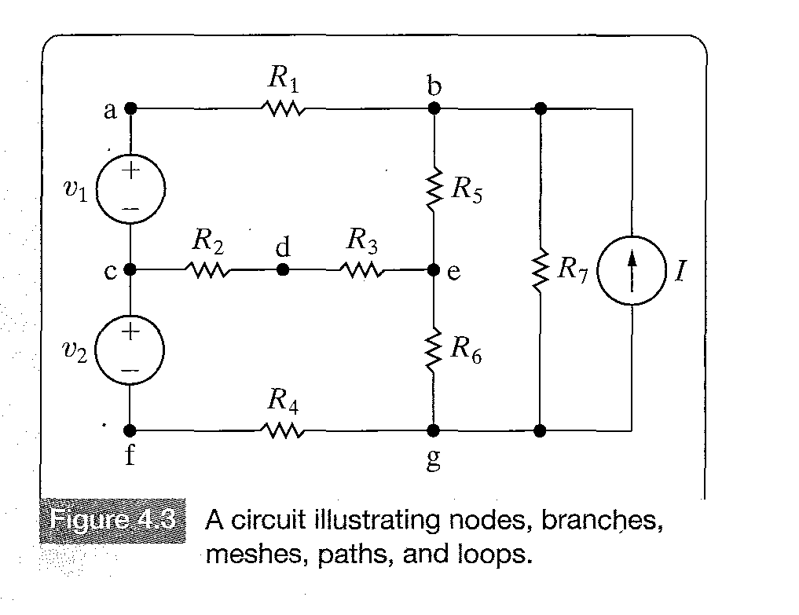
EXAMPLES OF CIRCUIT VOCABULARY

Slide 7
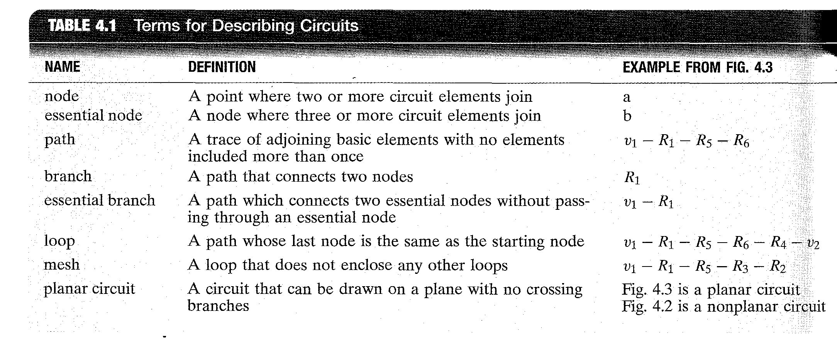
EXAMPLES OF CIRCUIT VOCABULARY

Slide 8
SIMULTANEOUS EQUATIONS
Let b be the number of branches of a circuit where the current is not known.For example in the circuit of Figure 4.3 below there are 9 branches,where the current is not known.

Slide 9
SIMULTANEOUS EQUATIONS
To determine the b unknown currents we need b equations. Let n be the number of nodes in a circuit,then n-1 of these b equations can be derived using Kirchoff’s Current Law.Remember that Kirchoff’s current law yields n-1 linearly independent equations in a circuit with n nodes.The remaining b-(n-1) equations can be determined by applying Kirchoff’s voltage law to loops or meshes.
Thus,Kirchoff’s current law is applied to n-1 nodes and Kirchoff’s voltage law is applied to b-(n-1) loops or meshes to write the necessary number of equations to solve for all the unknown currents.

Slide 10
SIMULTANEOUS EQUATIONS
The above results are also valid for essential nodes.Let ne represent the number of essential nodes in a circuit and be the number of essential branches where the current is not known.Kirchoff’s current law can be applied to ne-1 nodes and Kirchoff’s voltage around be-(ne-1) loops or meshes.
As ne <= n and be <=b,that is the number of essential nodes is less than or equal to the total number of nodes in a circuit and the number of essential branches is less than or equal to the total number of branches in a circuit,using essential nodes and branches when analyzing a circuit leads to fewer independent equation to be solved.

Slide 11
SIMULTANEOUS EQUATIONS
A circuit may consist of disconnected parts.If a circuit has n nodes and b branches and is made up of s parts,the current law can be applied n-s times,and the voltage law b-n+s times.Any two seperate parts of a circuit can be connected by a single conductor.This connection combines two nodes into a single node.

Slide 12
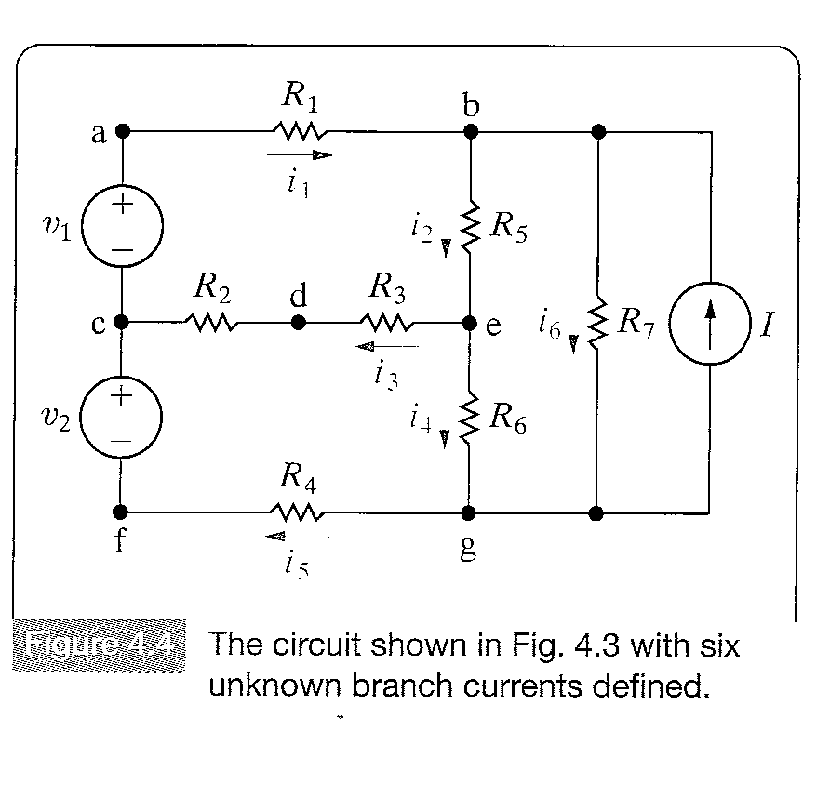
THE SYSTEMATIC APPROACH

Slide 13
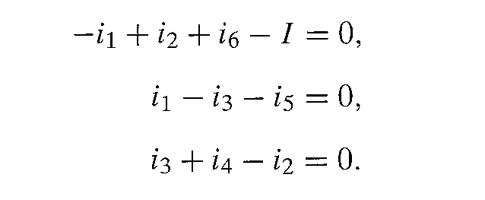
THE SYSTEMATIC APPROACH
We write the equations on the basis of essential nodes and branches.The circuit above has four essential nodes and six essential branches denoted i1,i2,i3,i4,i5,i6 for which the current is unknown.
Using three of the four nodes three of the six equations required to solve for the unknowns can be determined.Using nodes b,c and e we get:
4.7

Slide 14
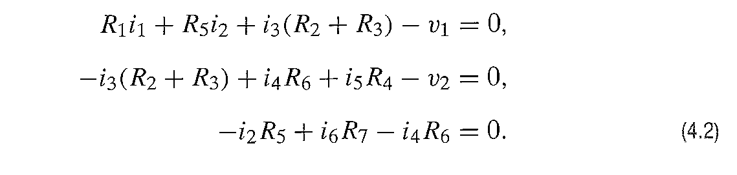
THE SYSTEMATIC APPROACH
The remaining equations will be derived using Kirchoff’s voltage law around three of the four meshes of the circuit.One of the meshes R7-I is not included, as the current I is not known.
Using the other three meshes

Slide 15
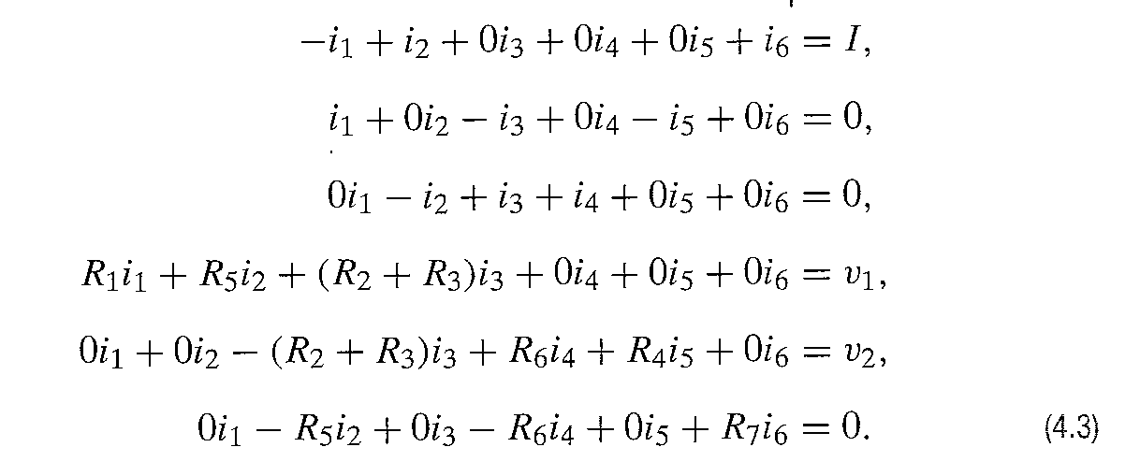
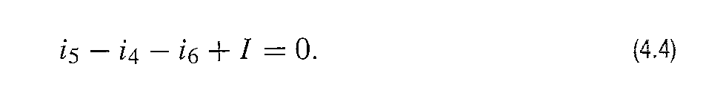
THE SYSTEMATIC APPROACH
Rearranging Equations 4.1 and 4.2 yields
Note that the current at the nth node gives

Slide 16
THE SYSTEMATIC APPROACH
Equation (4.4) is not independent,because it can be obtained by summing Equations 4.1 and then multiplying the sum by -1.By introducing new variables,a circuit can be described with just n-1 equations or just b-(n-1) equations.
These new variables are known as node voltages and mesh currents.The node-voltage method decribes a circuit in terms of ne-1 equations;the mesh-current method describes a circuit in terms of be-(ne-1) equations.

Slide 17
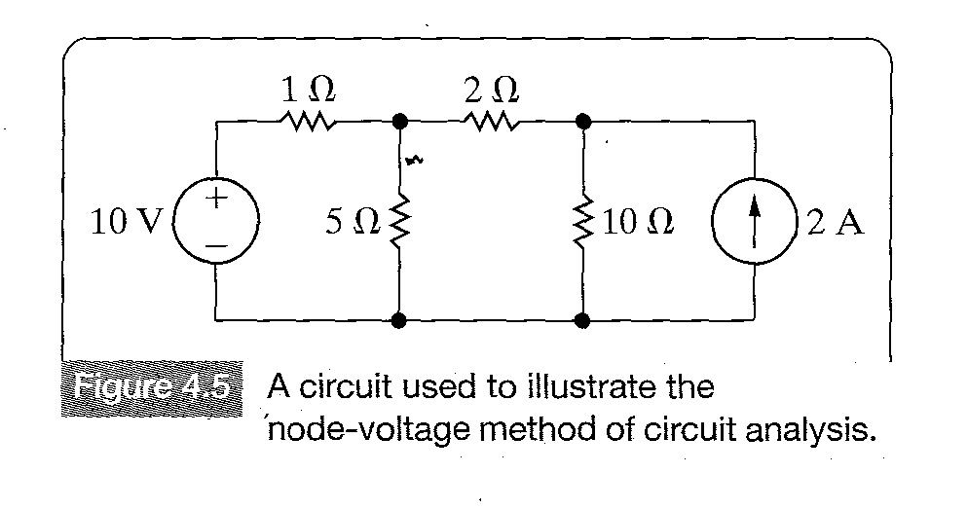
INTRODUCTION TO NODE-VOLTAGE METHOD

Slide 18
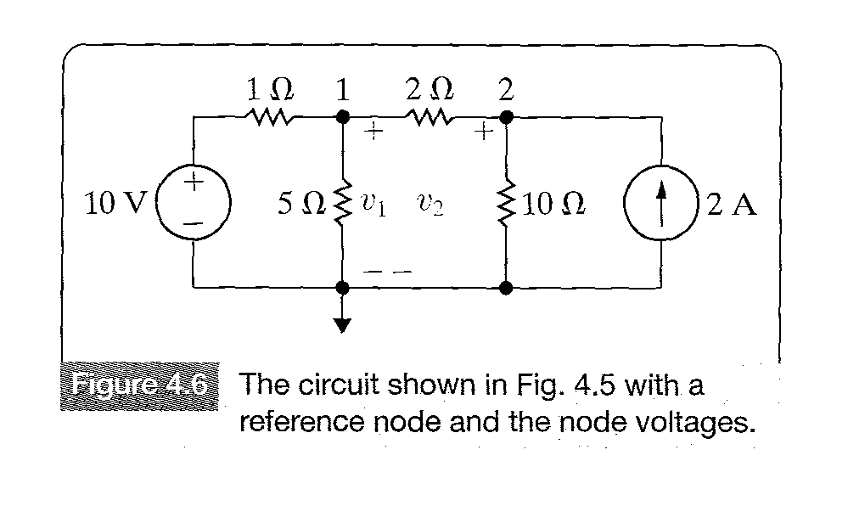
INTRODUCTION TO NODE-VOLTAGE METHOD
The above circuit will be analyzed by using essential nodes. The circuit is redrawn indicating the essential nodes and the voltages.The circuit has three essential nodes (ne=3),therefore we need ne-1=2, node-voltage equations to describe the circuit.

Slide 19
INTRODUCTION TO NODE-VOLTAGE METHOD
Next we select one of the essential nodes as the reference node.Usually,the node with most branches is a good choice.The lower node has been selected as the reference node.
Once the reference node is selected,node voltages can be defined.
A node voltage is defined as the voltage rise from the reference node to a non-reference node.For the above circuit the two node-voltages defined are v1 and v2.

Slide 20
INTRODUCTION TO NODE-VOLTAGE METHOD
Node voltage equations are written by expressing the current leaving each branch connected to a nonreference node as a function of the node voltages and then summing these currents according to Kirchoff’s current law.
Consider the current away from node 1 through the 1 resistor,by ohm’s law,it is the voltage drop divided by the resistor,thus it is (v1-10)/1.Figure 4-7 shows this observation.

Slide 21
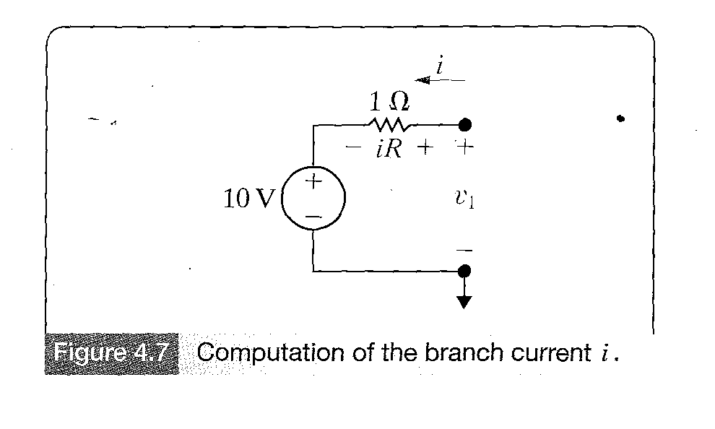
INTRODUCTION TO NODE-VOLTAGE METHOD
Figure 4-7

Slide 22
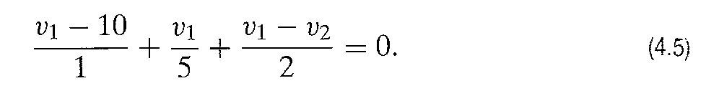
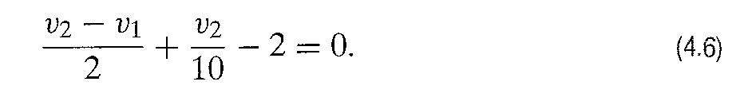
INTRODUCTION TO NODE-VOLTAGE METHOD
By the same reasoning and considering that all currents must add up to zero for node 1 we obtain:
For node 2,we obtain

Slide 23
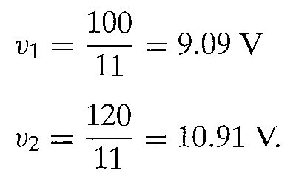
INTRODUCTION TO NODE-VOLTAGE METHOD
Note the first term in equation 4-6 is the current away from node 2 through the 2 Resistor,the second term is the current away from node 2 through the 10 Resistor,and the third term is the current away from node 2 through the current source
Solving for v1 and v2.
Once the node voltages are known, all the branch currents can be calculated. After the branch currents are calculated,the branch voltages and powers can be calculated.

Slide 24
INTRODUCTION TO NODE-VOLTAGE METHOD
Example 4.2-Assessing Objective 1

Slide 25
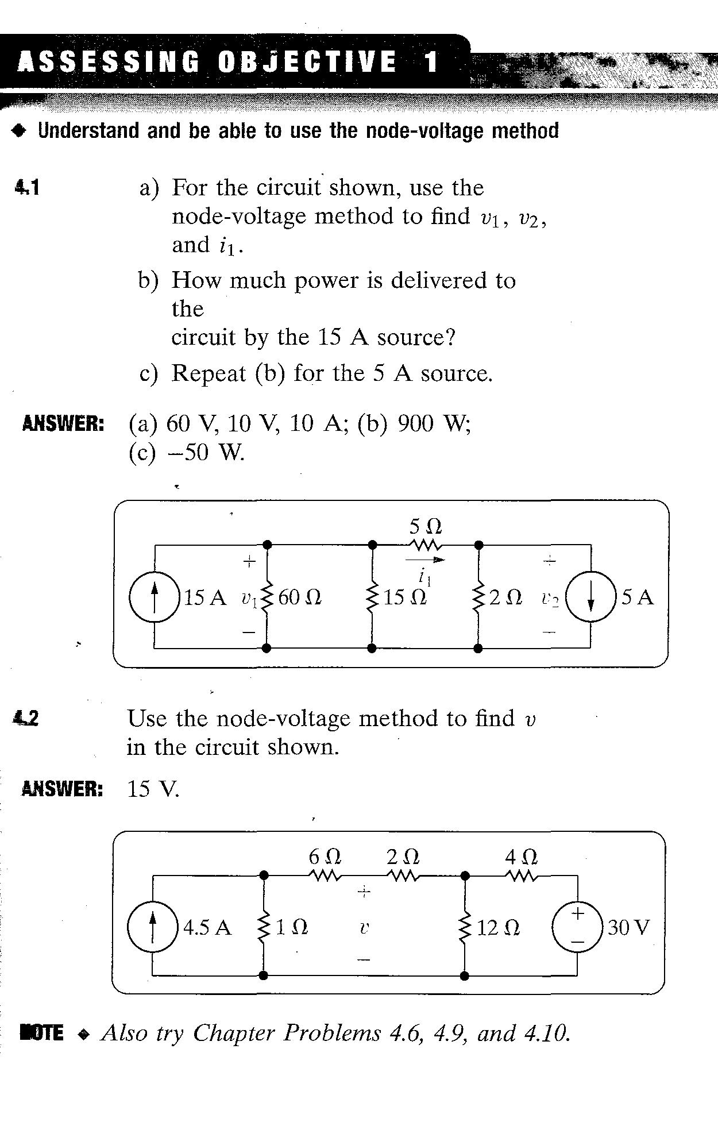
Homework Assessing Objective 1: 4.1,4.2

Slide 26
THE NODE-VOLTAGE METHOD AND DEPENDENT SOURCES
In circuits with dependent sources,the node-voltage equations must be supplemented with the constraint equations imposed by the presence of the dependent sources.
Example 4.3

Slide 27
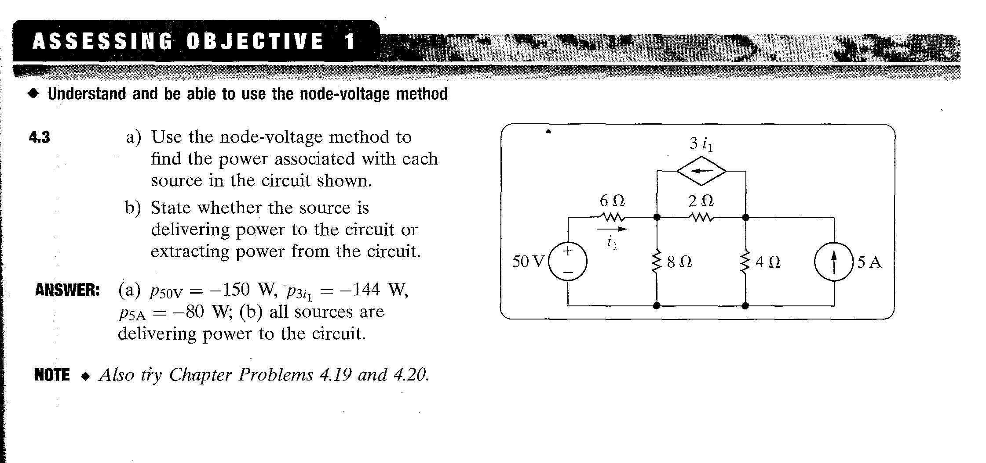
Homework Assessing Objective 1: – 4.3

Slide 28
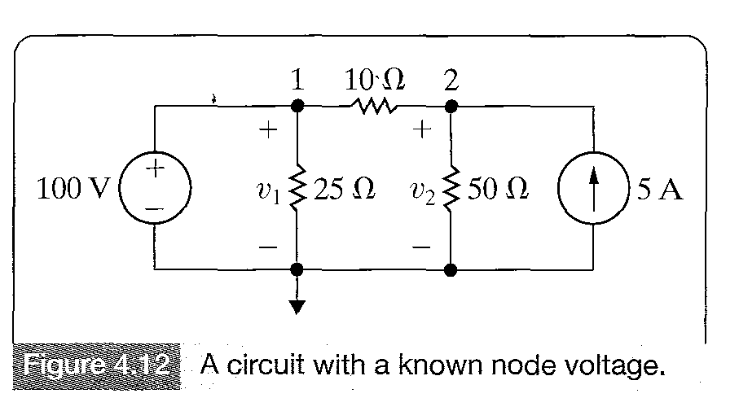
THE NODE-VOLTAGE METHOD: SOME SPECIAL CASES
Consider the circuit in Figure 4-12 shown below.Allthough the circuit contains three essential nodes and theoratically needs two equations,a closer look reveals that the 100 V voltage source constraints the voltage between the node 1 and the reference node to be 100V.Thus there is only a single unknown voltage in this circuit .It is the voltage v2.

Slide 29
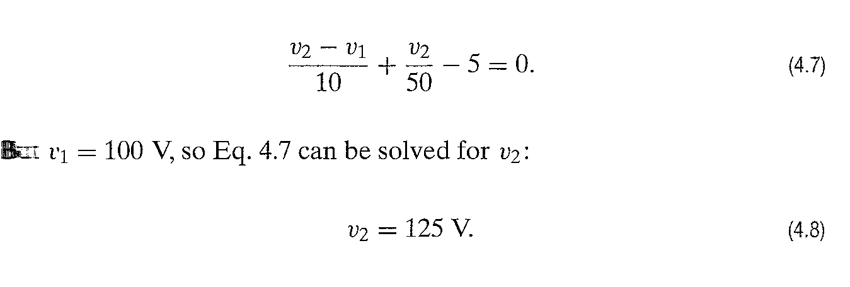
THE NODE-VOLTAGE METHOD: SOME SPECIAL
Once the node voltages v1 and v2 are known,all unknown currents in branches can be computed.
The current is generated by the 100 V source is

Slide 30
THE NODE-VOLTAGE METHOD: SOME SPECIAL CASES
When voltage sources are connected directly between essential nodes,the number of unknown node voltages is reduced.This is because the voltage source connected between two essential nodes constraints the difference between the node voltages of these nodes to equal the voltage source.

Slide 31
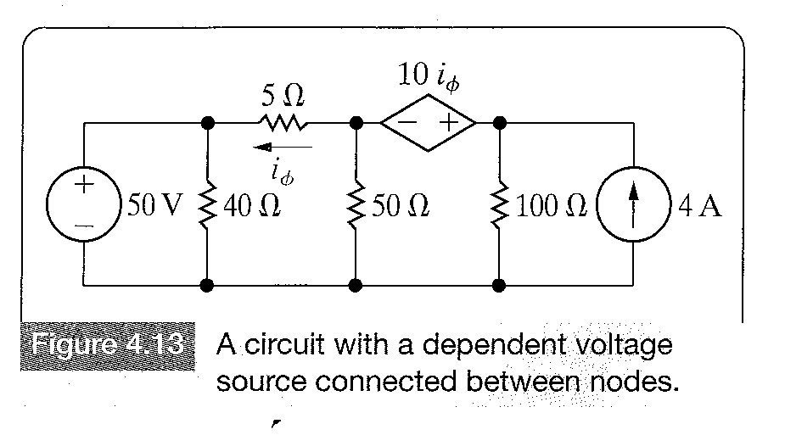
THE NODE-VOLTAGE METHOD: SOME SPECIAL CASES
Suppose that the circuit shown in Figure 4.13 is to be analyzed using the node-voltage method.

Slide 32
THE NODE-VOLTAGE METHOD: SOME SPECIAL CASES
The circuit contains four essential nodes,so it is expected that three node-voltage equations will be wriitten.However,two essential nodes are connected by an independent voltage source and two other essential nodes are connected by a current-controlled dependent voltage source.Thus there is actually only one unknown node voltage.
The lower node is selected as the reference node,for two reasons first one of the voltages of the nodes connected to that node is already known,it is 50V,and second 5 branches terminate there.

Slide 33
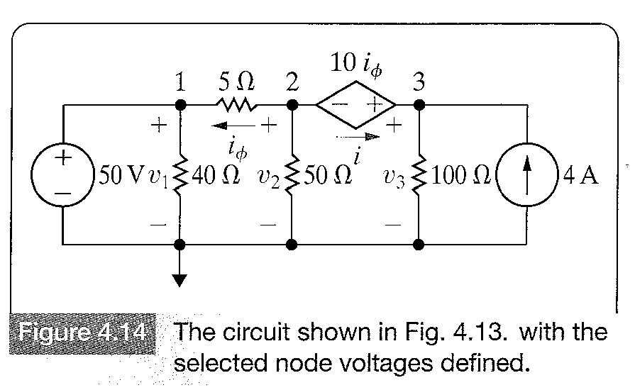
THE NODE-VOLTAGE METHOD: SOME SPECIAL CASES
Figure 4.14 shows the redrawn circuit,with the reference node and the essential nodes.Also,because the current in the dependent source cannot be expressed as a function of the node voltages v1 and v, a current i is inroduced to represent it.

Slide 34
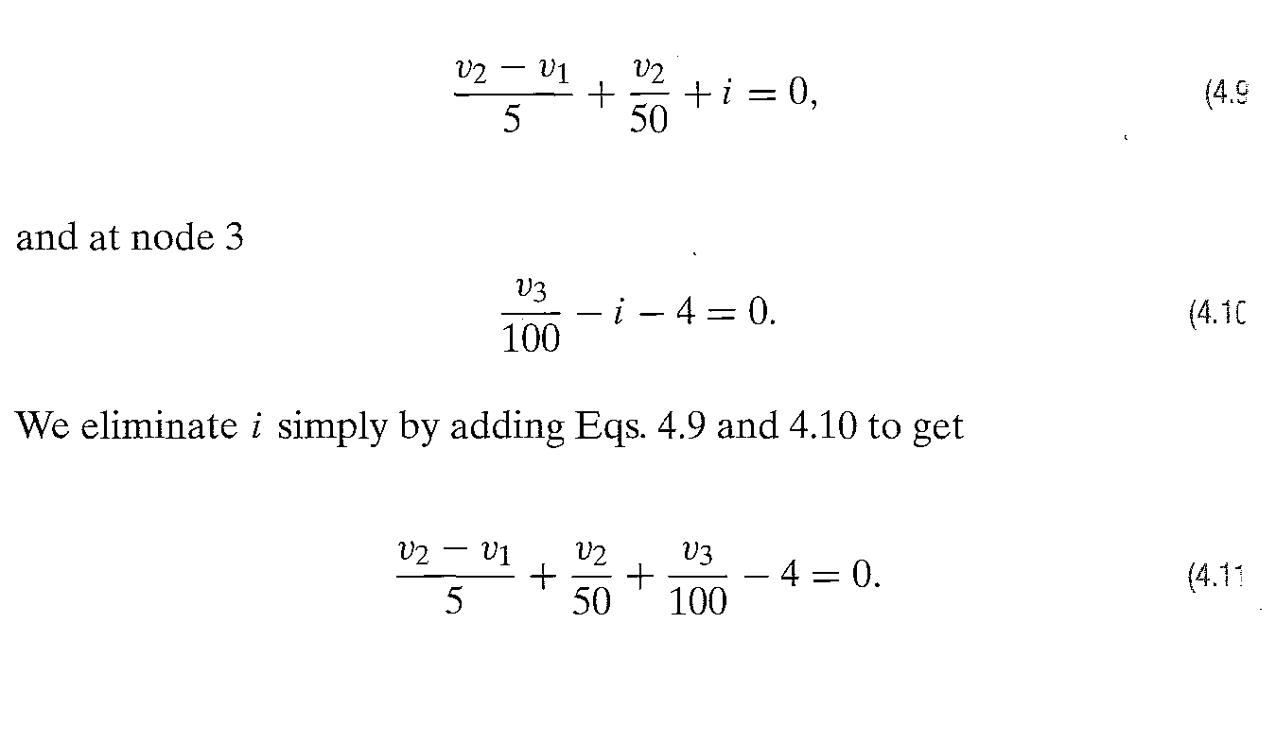
THE NODE-VOLTAGE METHOD: SOME SPECIAL CASES

Slide 35
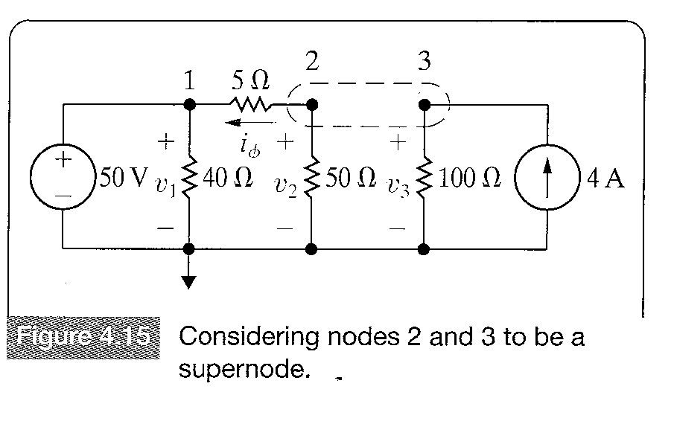
THE CONCEPT OF A SUPERNODE
We can write equation 4.11 directly without first writing equations 4.9 and 4.10.In order to do this we assume that nodes 2 and 3 are a single node and simply add up currents away from this node.Figure 4.15 illustrates this approach.

Slide 36
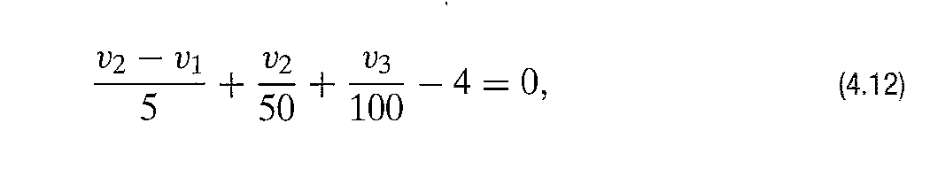
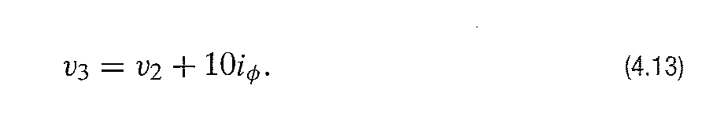
THE CONCEPT OF A SUPERNODE
When a voltage source is between two essential nodes,we can combine those nodes to form a supernode.Kirchoff’s current law obviously holds for the supernodes as well.
In Figure 4-15,starting with the 5 resistor and moving around the supernode counterclockwise,we get the following equation:
The equation above is identical to equation 4.11.
Next the voltage v1 is eliminated,because we know that v1=50 V and v3 is expressed as a function of v2.

Slide 37
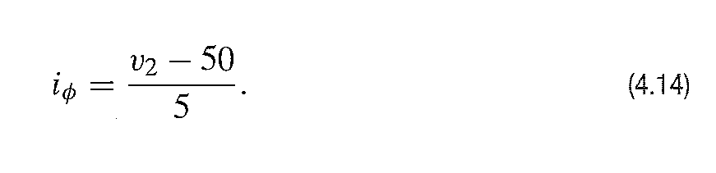
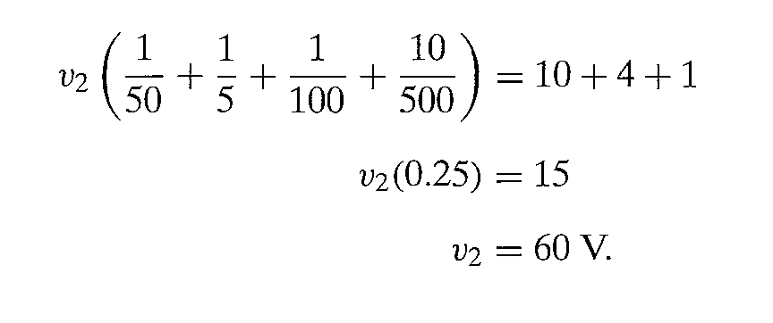
THE CONCEPT OF A SUPERNODE
Then the current controlling the dependent source is expressed as a function of the node voltages.
Using Equations 4-13 and 4-14 and v1=50V reduces Equation 4.12 to

Slide 38
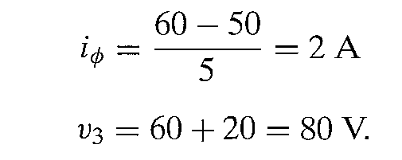
THE CONCEPT OF A SUPERNODE
From Equations 4-13 and 4-14

Slide 39
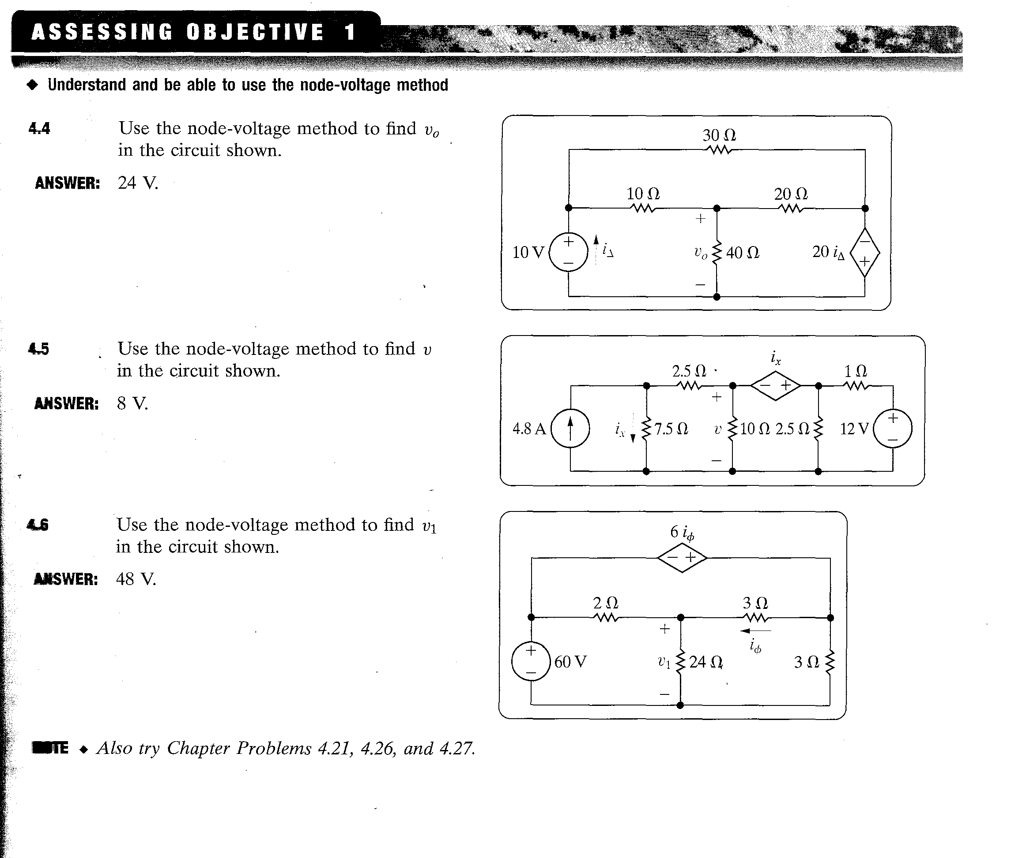
Homework Assessing Objective 1: – 4.4,4.5,4.6

Slide 40
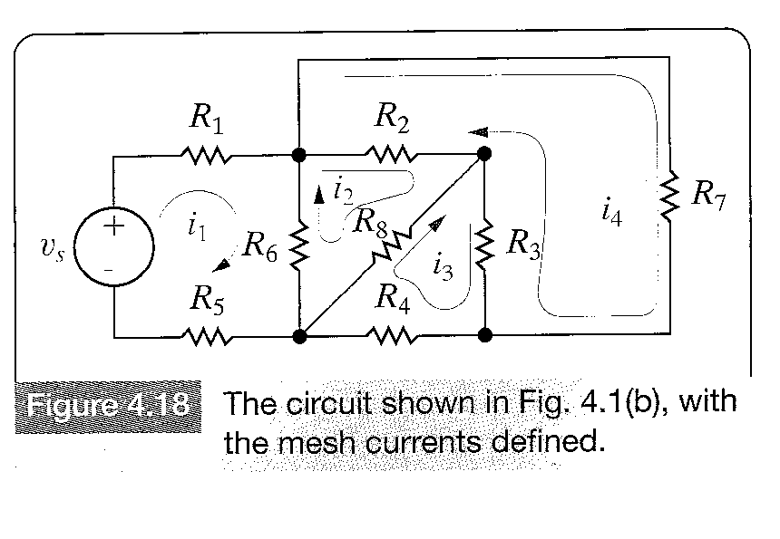
INTRODUCTION TO THE MESH CURRENT METHOD
A mesh is a loop with no other loops inside.The mesh-current method of circuit analysis enables us to describe a circuit in terms of be-(ne-1) equations.Mesh-current method is applicable only to planar circuits.The circuit in Figure 4-18 contains seven essential branches where the current is unknown and four essential nodes.Thus to be able to solve the circuit via the mesh-current method,we must write (7-(6-1)) = 2 mesh current equations.

Slide 41
INTRODUCTION TO THE MESH CURRENT METHOD
A mesh current exist only in the perimeter of a mesh and all mesh currents automatically satisfy Kirchoff’s current law.This is because at any given node of a circuit the mesh current both enters and leaves the node.
A mesh current does not always equal to a branch current.For example,the mesh current i2 is not equal to any branch current,whereas mesh currents i1,i3 and i4 can be identified with branch currents.Measuring mesh current is not always possible,a mesh current is an imaginary quantity,only if a mesh current equals a branch current, it can be measured by an ampermeter.

Slide 42
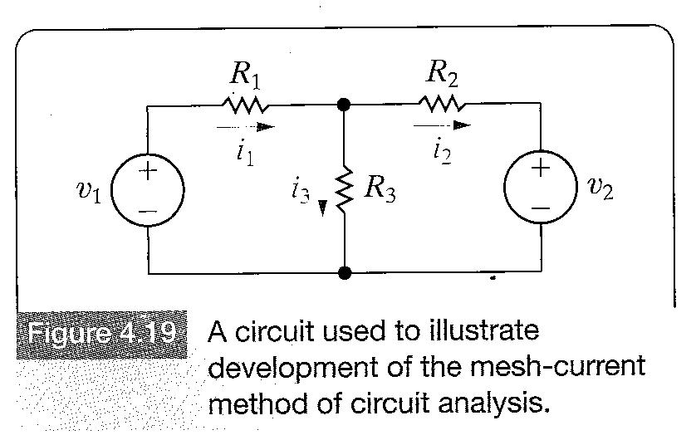
INTRODUCTION TO THE MESH CURRENT METHOD
We use the circuit of Figure 4-19 to show the evolution of mesh current technique.We first assign branch currents i1,i2 and i3 to formulate the set of independent equations.
For this circuit,be = 3 and ne = 2.We can write one independent current equation.The remaining two equations to determine the unknown currents should come from Kirchoff’s voltage law equation.

Slide 43
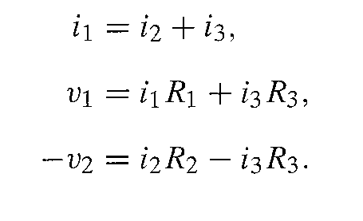
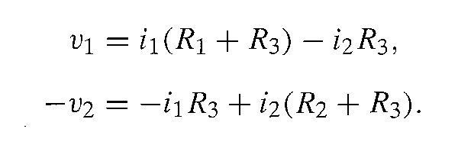
INTRODUCTION TO THE MESH CURRENT METHOD
We apply Kirchoff’s current law at the upper node and Kirchoff’s voltage law around the two meshes.
4.20
4.21
4.22
By solving for i3 from equation (4.20) and substituting into (4.21) and (4.22),we get
4.23
4.24

Slide 44
INTRODUCTION TO THE MESH CURRENT METHOD
Equation 4.23 has been derived by substituting the ne-1 current equations into the be-(ne-1) voltage equations.Mesh current method enables us to eliminate the ne-1 current equations.Thus it is equivalent to a systematic subtitution of ne-1 current equations into the be-(ne-1) voltage equations.
The mesh currents which eliminate the branch current i3 from Equations 4-21 and 4-22 are shown in Figure 4.20.
Applying Kirchoff’s voltage law around two meshes and expressing all voltages across the resistors in terms of the mesh currents,we get the following equations

Slide 45
Assessing Objective 1

Slide 46
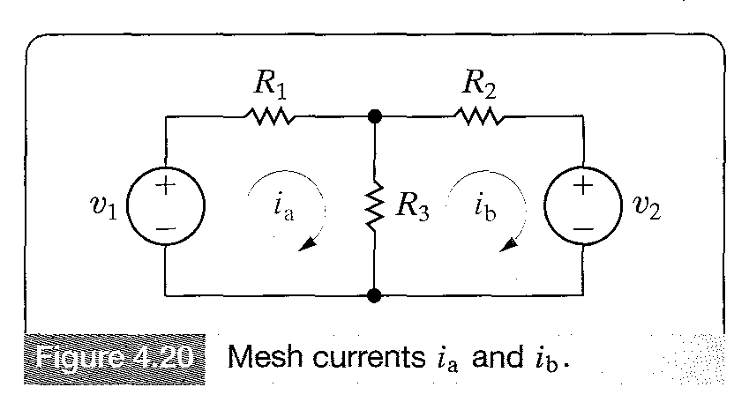
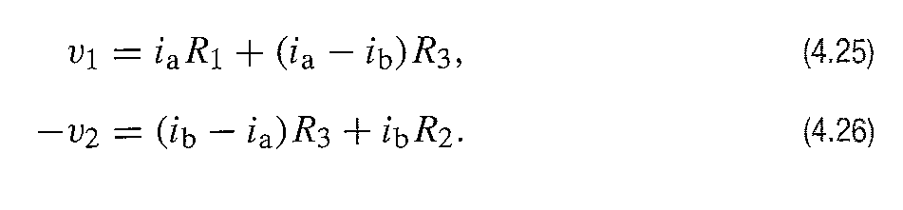
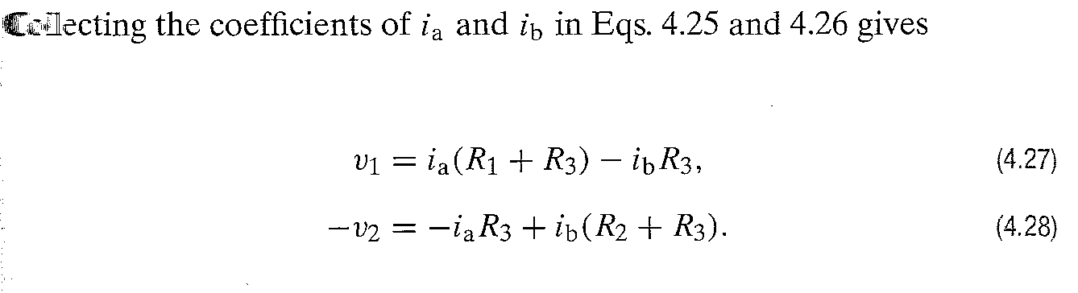
INTRODUCTION TO THE MESH CURRENT METHOD
Once the mesh currents are known,the branch currents can be determined.Knowing the branch currents the voltages and powers of interest can be computed.

Slide 47
INTRODUCTION TO THE MESH CURRENT METHOD
Example 4.4

Slide 48
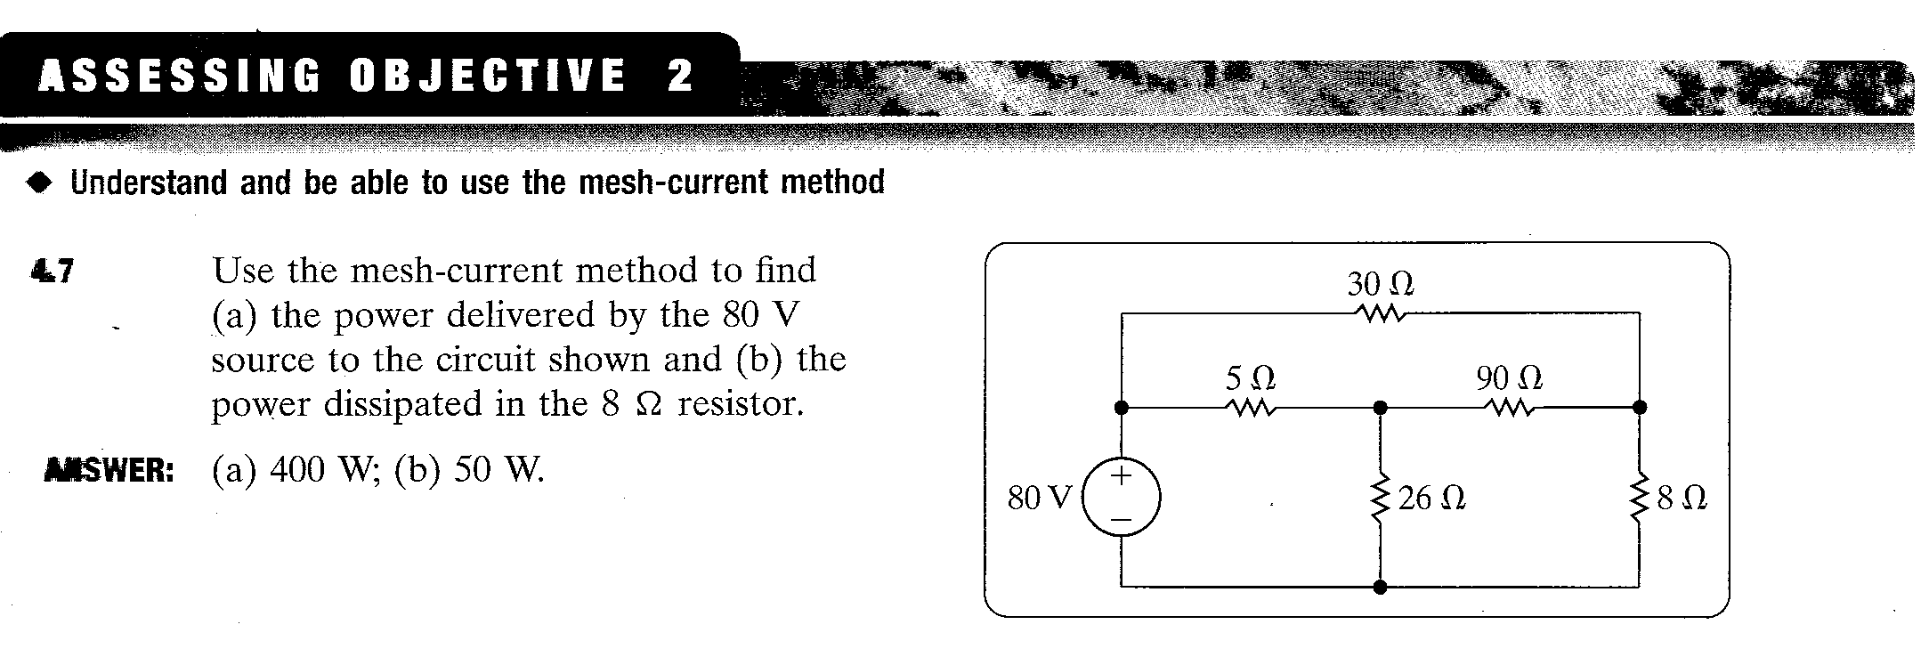
Homework: Assesing Objective 2 : 4.7

Slide 49
THE MESH CURRENT METHOD & DEPENDENT SOURCES
If the circuit contains dependent sources,the mesh current equations must be supported by the appropriate constraint equations.
Assessing Objective 2 (4.7), Example 4.5

Slide 50
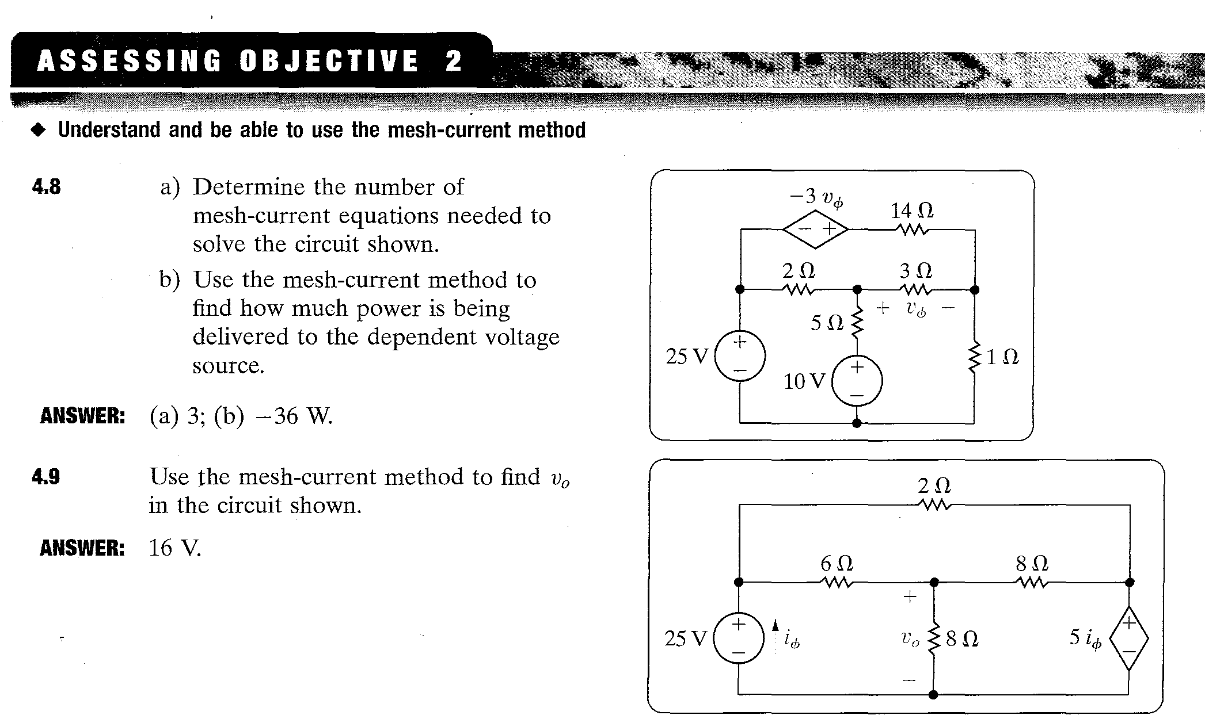
Homework: Assessing Objective 2 : 4-8 and 4-9

Slide 51
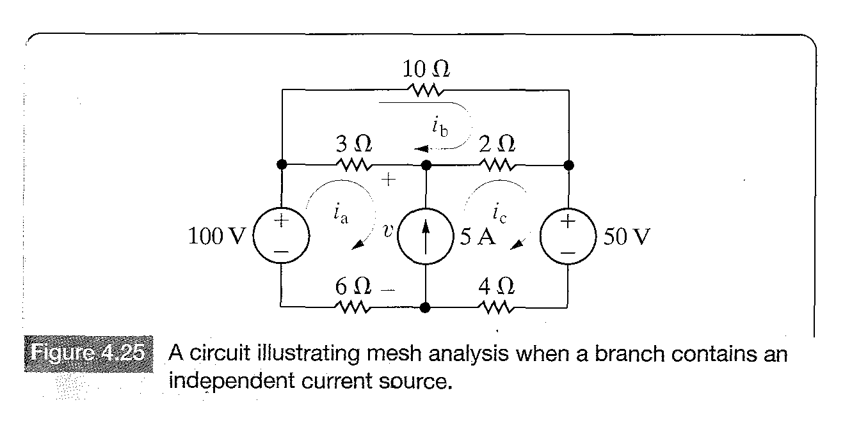
THE MESH CURRENT METHOD SOME SPECIAL CASES
When a branch contains a current source, the mesh-current method needs some additional manipılations.The circuit shown in Figure 4-25 shows the nature of the problem.

Slide 52
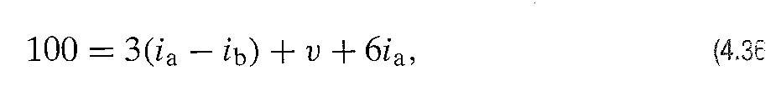
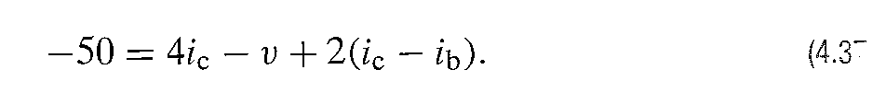
THE MESH CURRENT METHOD SOME SPECIAL CASES
Since the circuit contains five essential branches,where the current is unknown and five essential nodes,we need to write [5-(4-1)]=2 mesh-current equations to solve the circuit.
But, due to the current source the three unknown mesh currents are reduced to two unknown mesh currents.
The current source constraints the difference between ia and i2 to equal 5A.However,when writing the mesh equations we must define the unknown voltage across the 5A source as V and include it in the equations.Thus for mesh a we obtian:

Slide 53
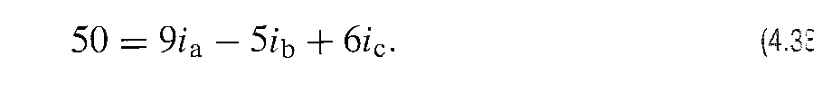
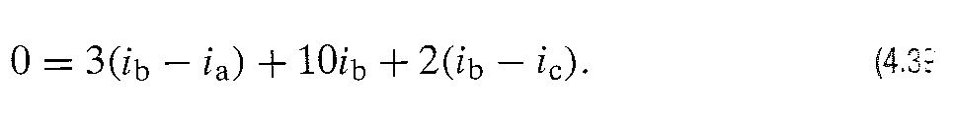
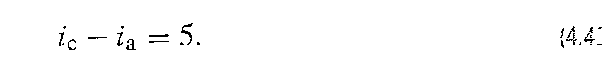
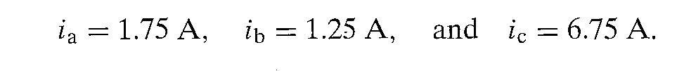
THE MESH CURRENT METHOD SOME SPECIAL CASES
Adding Equations 4-36 and 4-37 and eliminating we obtain
Summing voltages around mesh b gives.
By using the constraint ic-ia=5 (4-40) equations 4-38 and 4-39 can be reduced to two equations.
Finaly we get

Slide 54
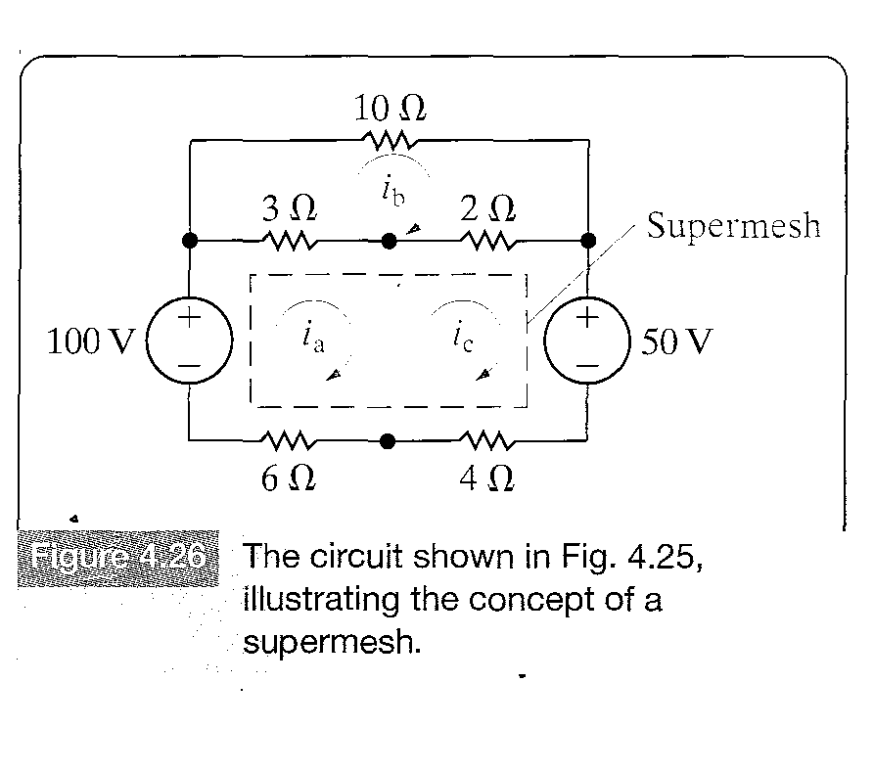
THE CONCEPT OF A SUPERMESH
Equation 4.38 can be derived without introducing the unknown voltage v by using the consept of a supermesh.

Slide 55
THE CONCEPT OF A SUPERMESH
To create a supermesh,we remove the current source from the circuit by simply avoiding this branch when writing the mesh-current equations.The voltages around the supermesh are expressed in terms of the original mesh currents.When the voltages around the supermesh (denoted by the dashed line) are considered,we obtain the following equation

Slide 56
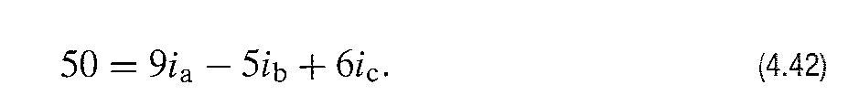
THE CONCEPT OF A SUPERMESH
Wich reduces to
Thus,the supermesh has eliminated the need for introducing the unknown voltage across the current source.

Slide 57
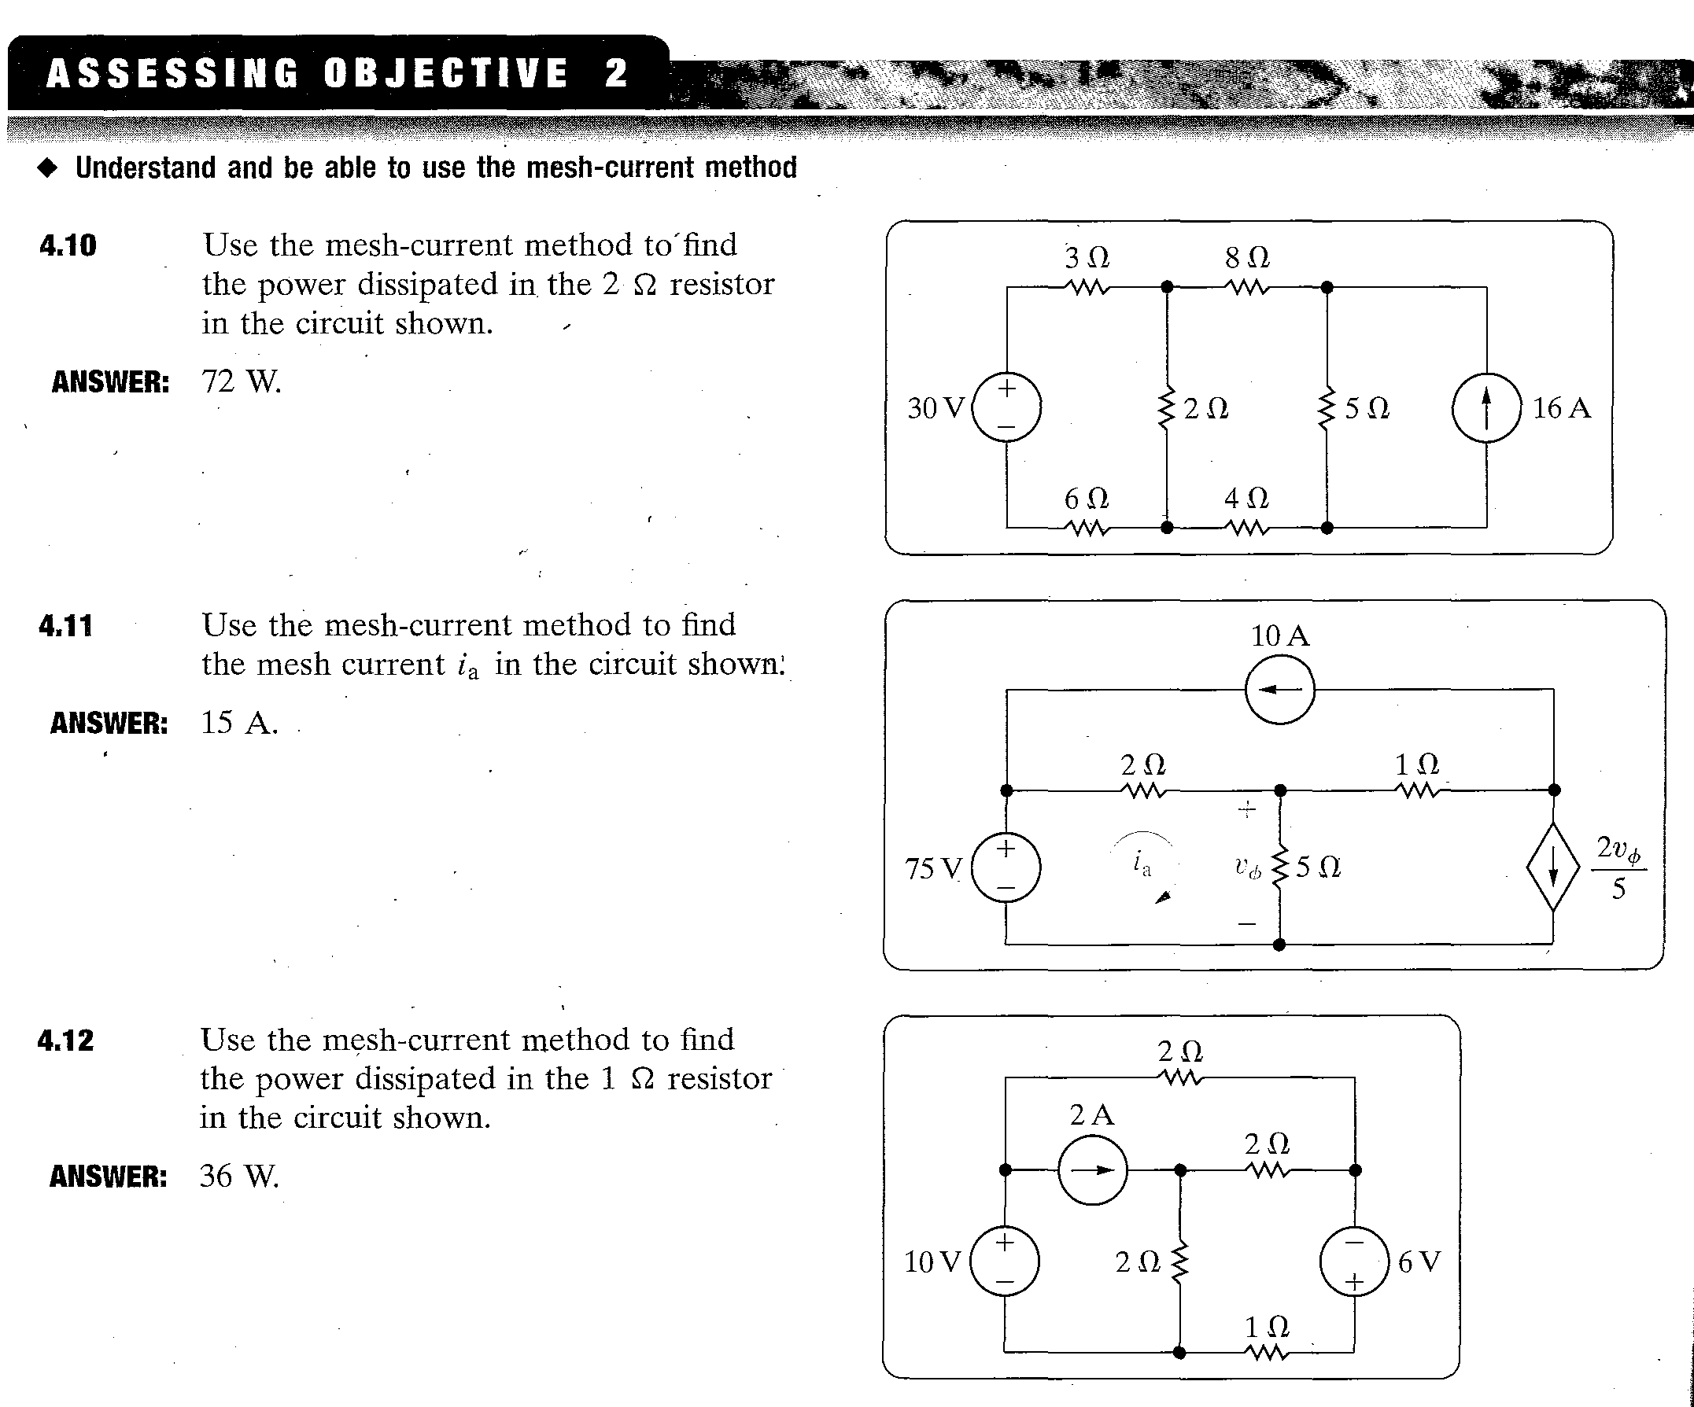
Homework : Assessing Objective 4.10-4.11

